Slide 1
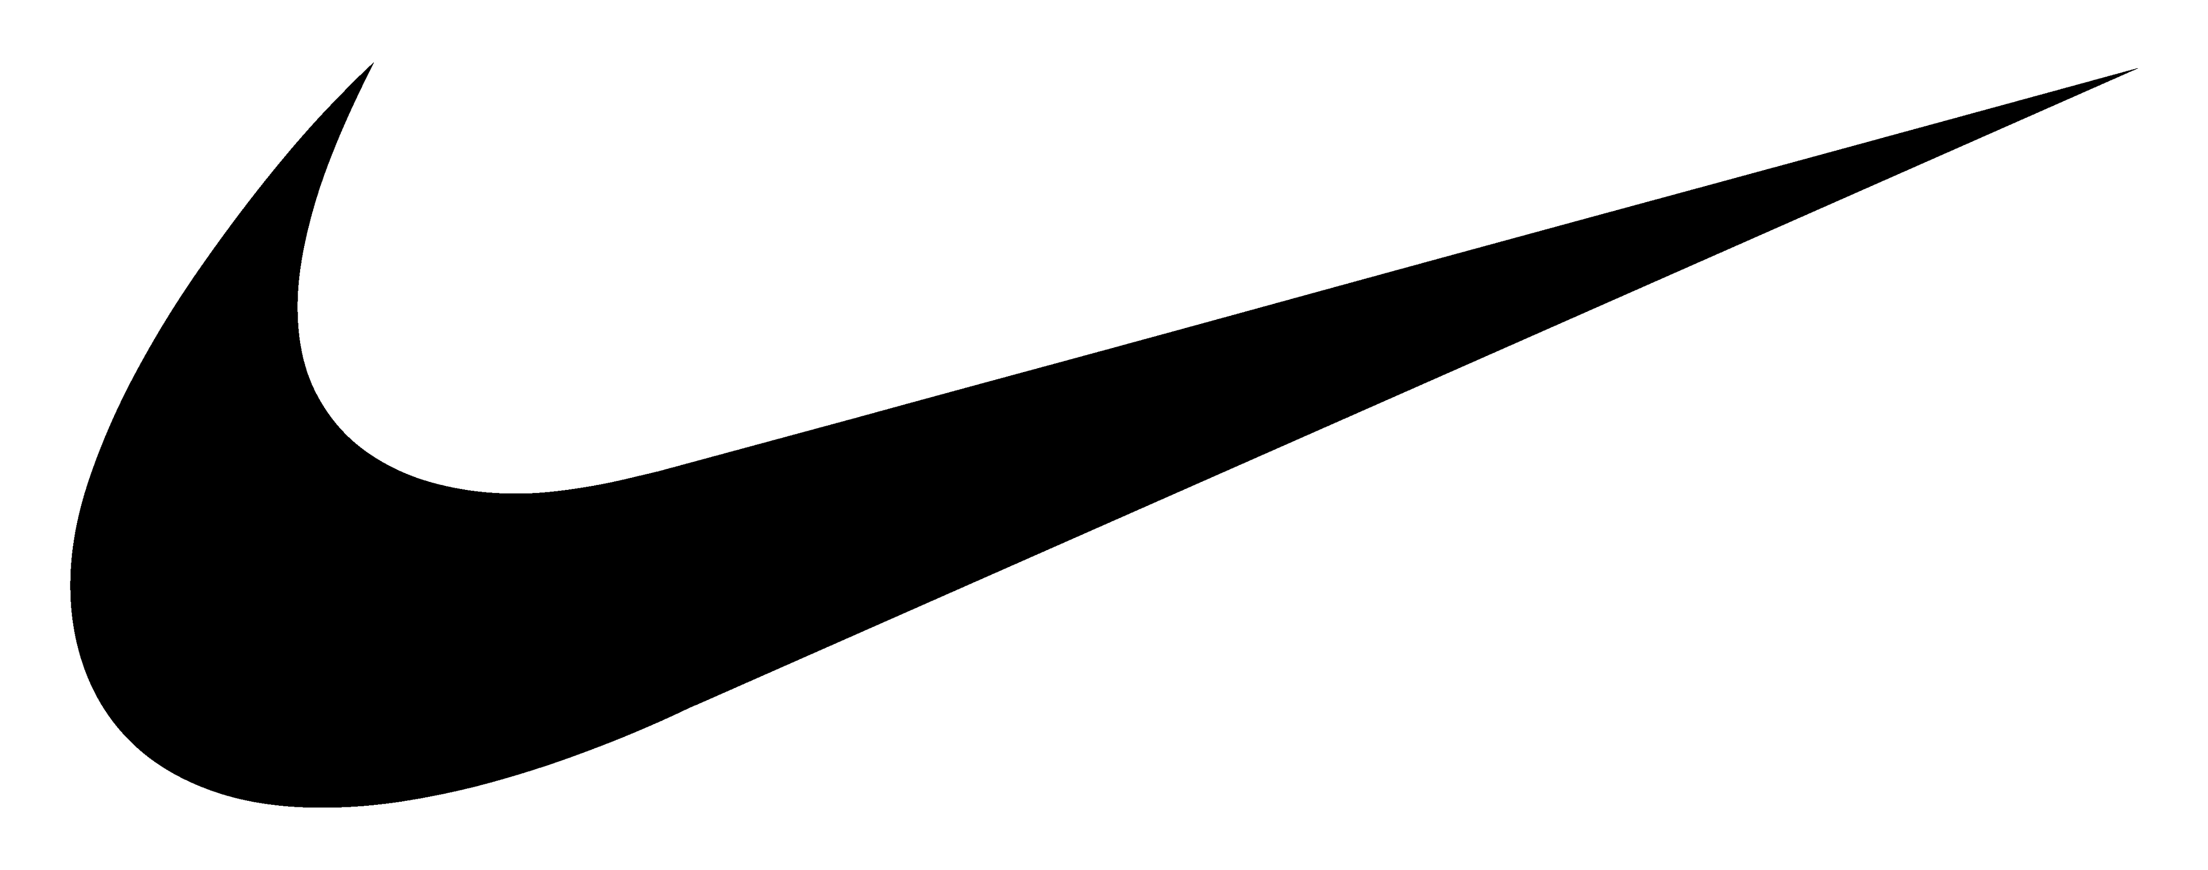

The effect of a sh*t storm:
A PR nightmare examined
Max Lembke
Case I: Text Analytics and Natural Language Processing (NLP)
01.20.2021

Slide 2
Agenda: ARE YOU ready TO SWEAT?
Agenda
Problem Statement & Background
Methodology
General Overview
Key Contributors: A timeline
Share of Voice: Does it matter?
Association Analysis: Who got involved?
Involvement of Nike: Why do we care?
Key Takeaways
Limitations & Further research

Slide 3
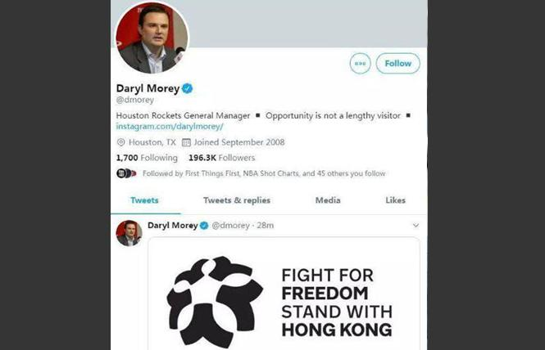
Problem Statement & Background
What happened in October 2019?
On the 5th of October 2019, Daryl Morey the general manager of the Houston Rockets, tweeted in support of the Hong Kong protest movement
Tycoon Tilman Fertitta bought the Houston Rockets for $2.2 billion (Record for the NBA at the time)
The Rockets had a big footprint in China, a key emerging market for the NBA but also the sportwear industry
Nike is a key sponsor of the NBA and the Rockets
Notes:
Credits:
https://www.wsj.com/articles/the-houston-rockets-were-chinas-team-then-a-hong-kong-tweet-happened-11570802945
https://www.12up.com/posts/rockets-gm-daryl-morey-apologizes-and-nba-makes-statement-after-hong-kong-tweet-causes-trouble-01dphveen9hh

Slide 4
Methodology
How was this analysis approached?
Over 400.000 tweets in October 2019
Limit to the start of the 5th of October to the end
Cleaning using established NLP techniques
Stopwords English – some minor additions
Examinations over time using Quanteda
Minor differences in cleaned terms

Slide 5
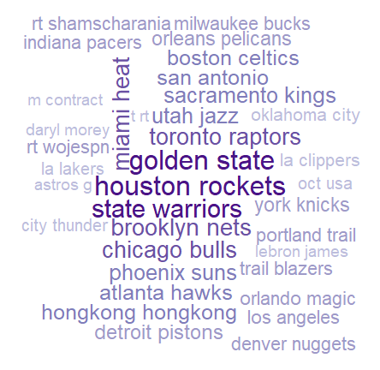
General Overview
What do we observe on a high level?

Slide 6
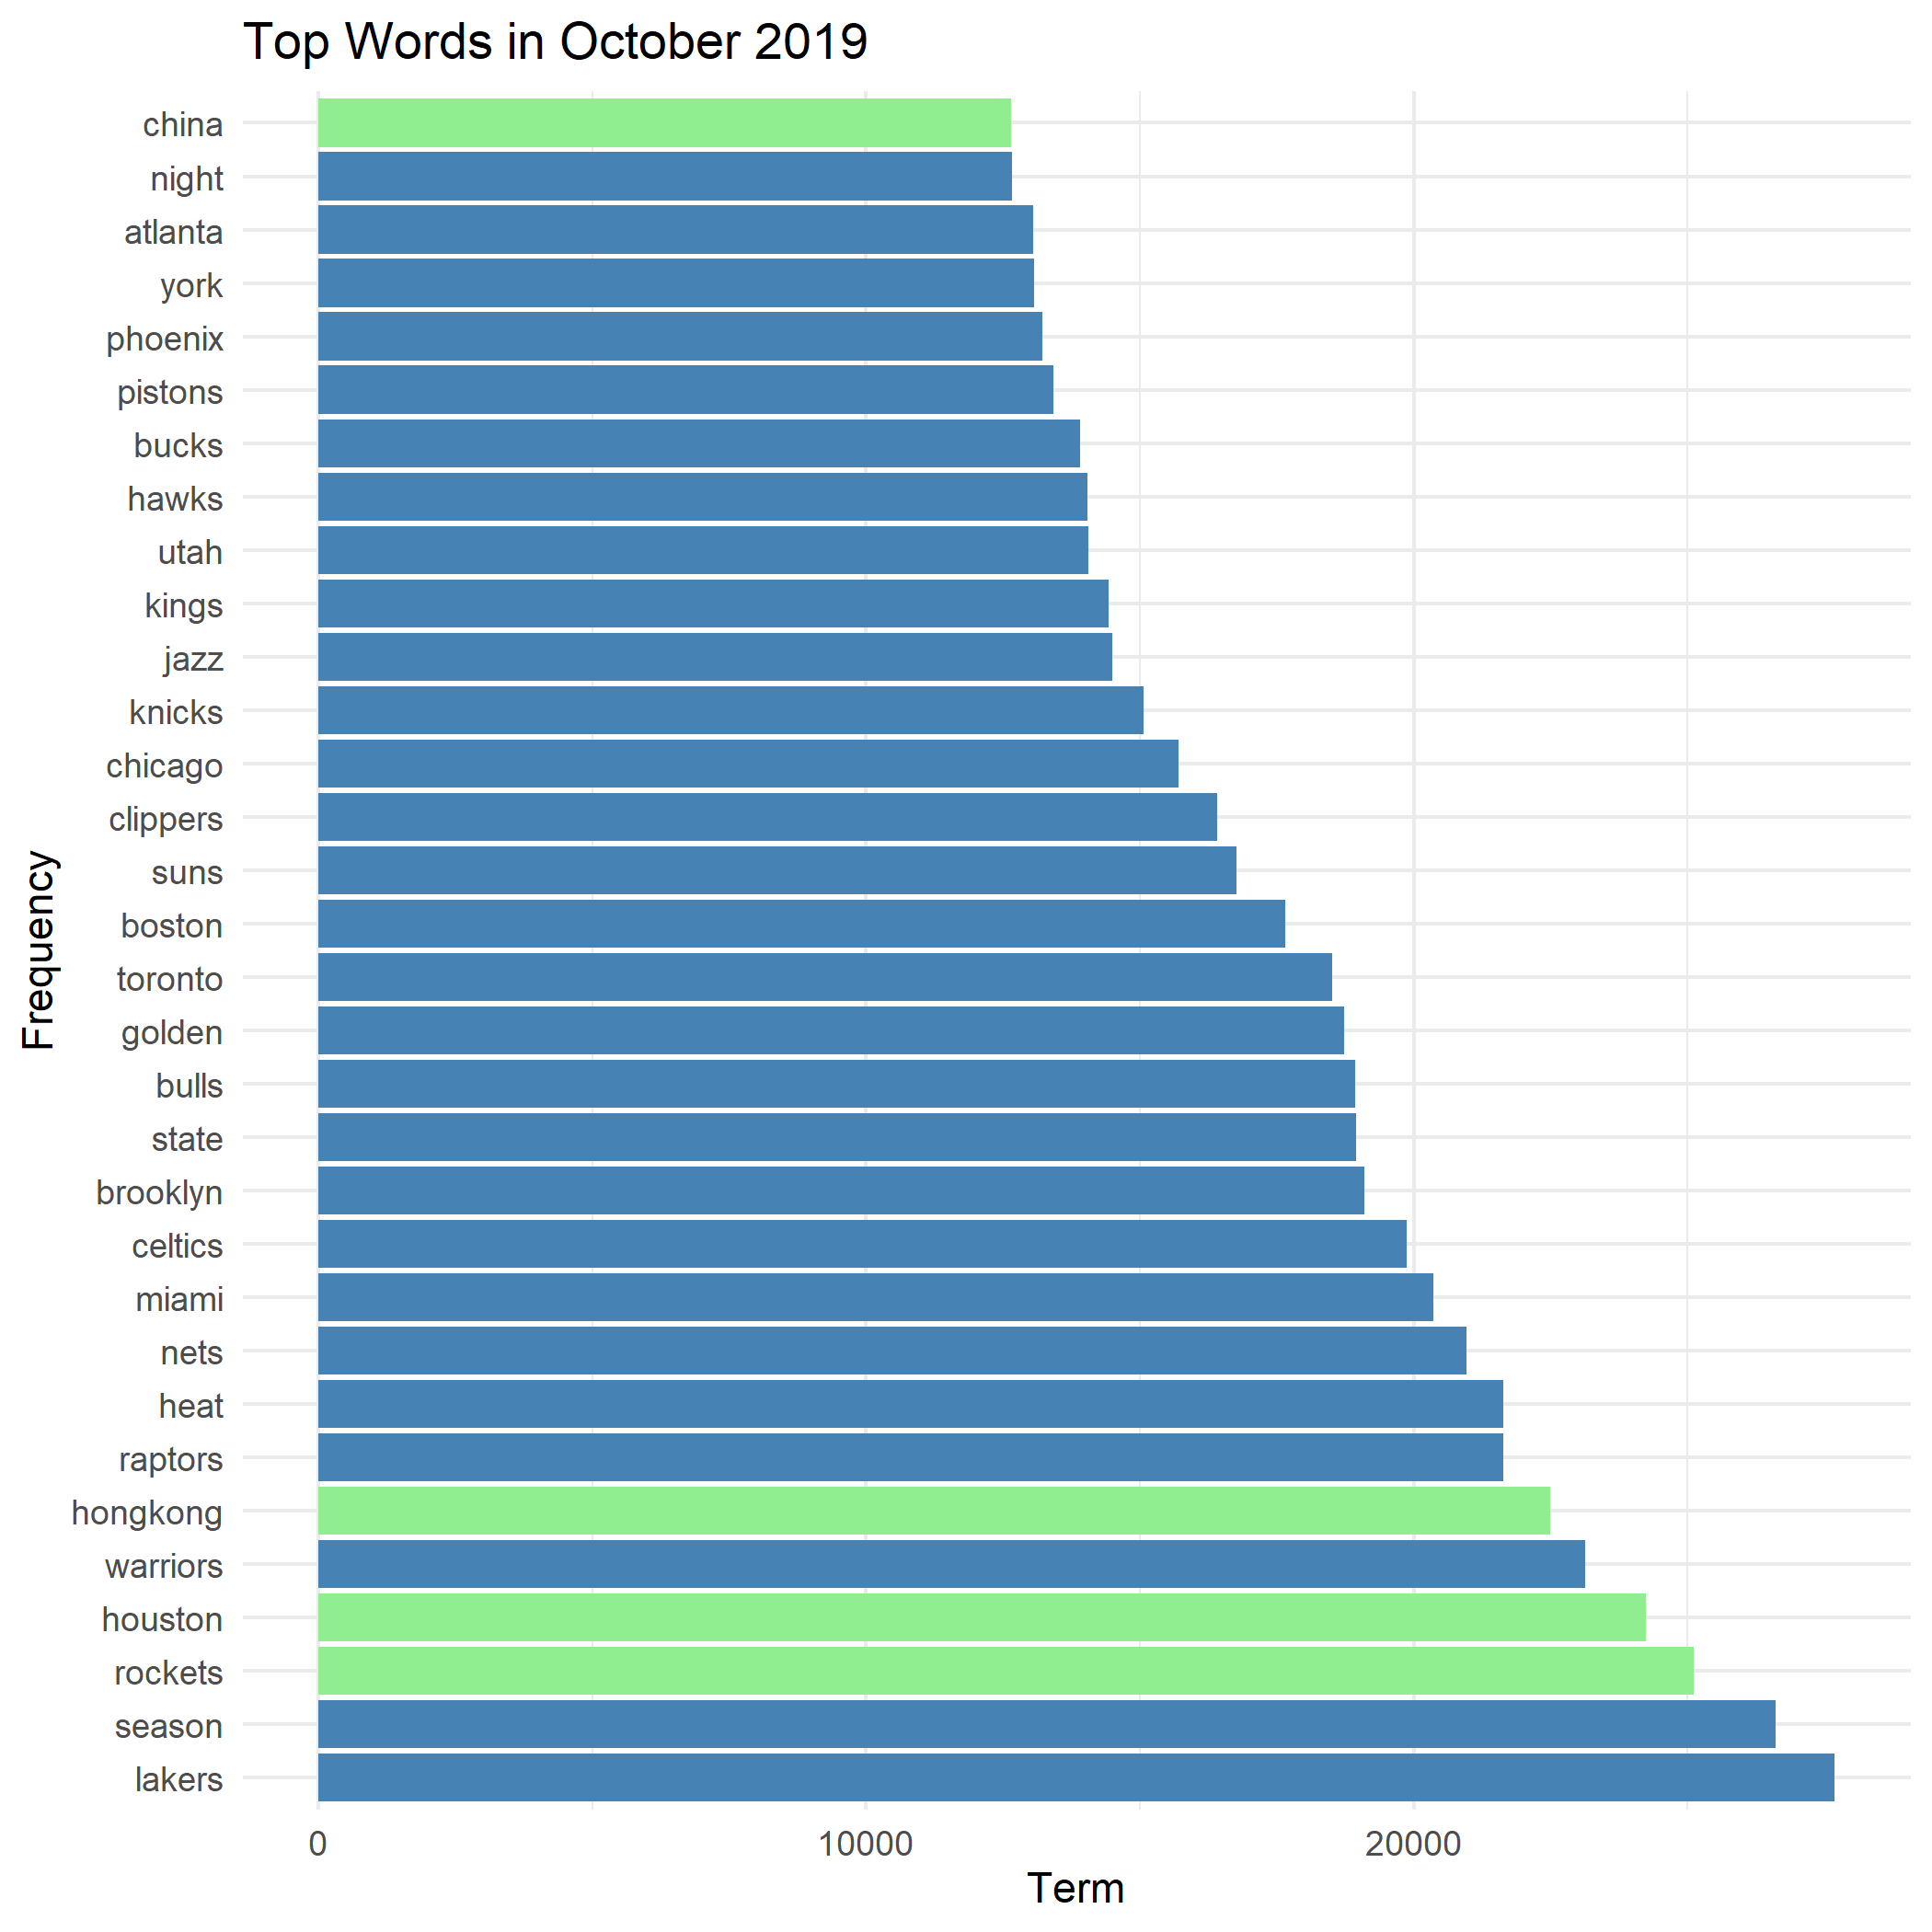
General Overview
A quantitative view
China & Hong-Kong dominating in mentions
Houston & Rockets also prominent terms

Slide 7
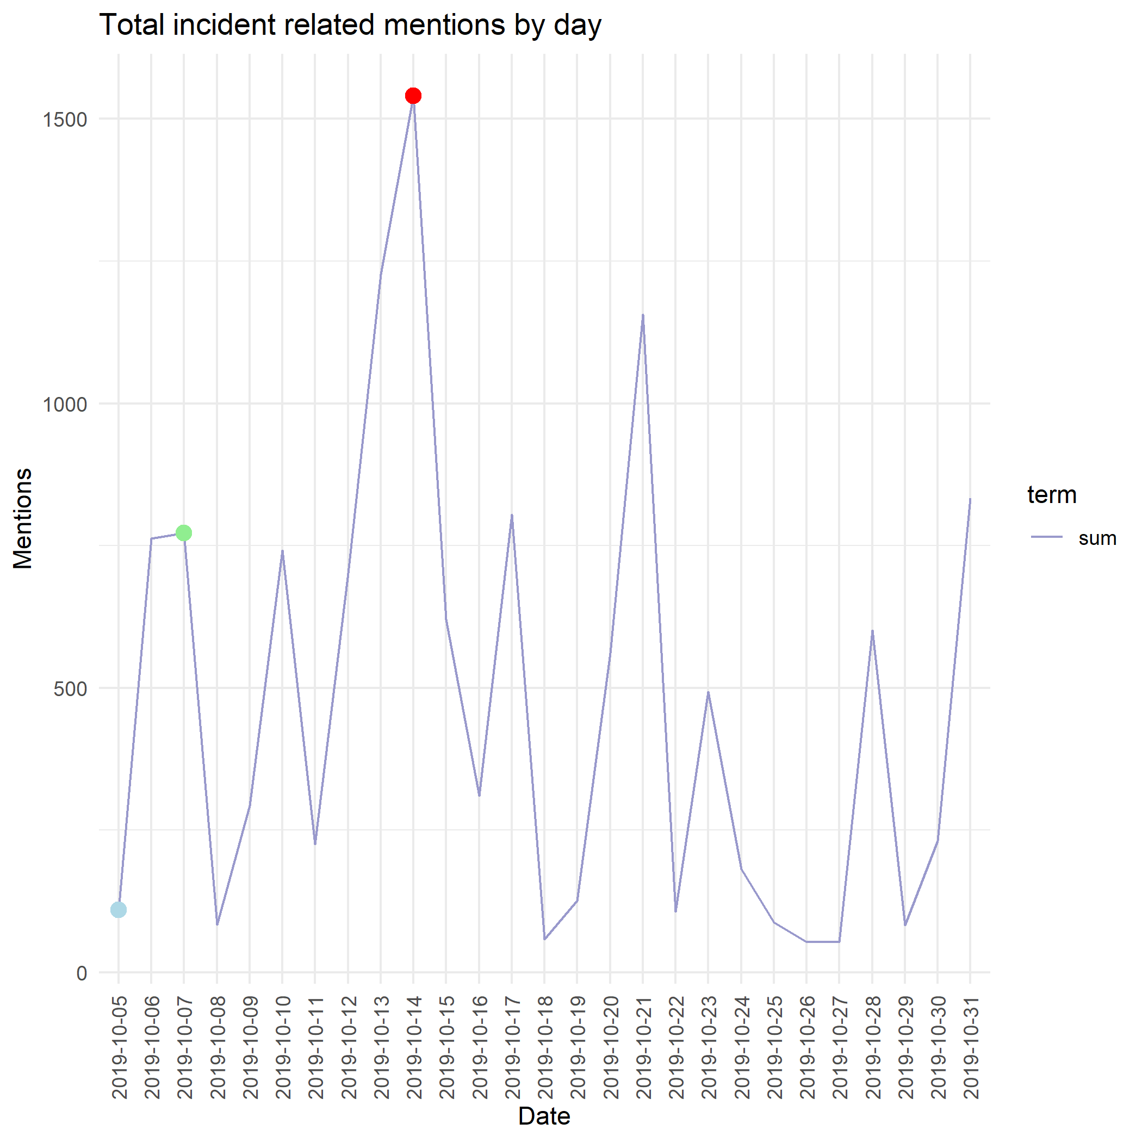
Key Contributors: A timeline
How did the uproar develop?
Incident Terms
China, Hong-Kong, Houston & Rockets
Initial tweet led to some uptick (blue mark)
Apology initially seemed to diffuse (green mark)
Involvement of Media and LeBron leading to spike (red mark)

Slide 8
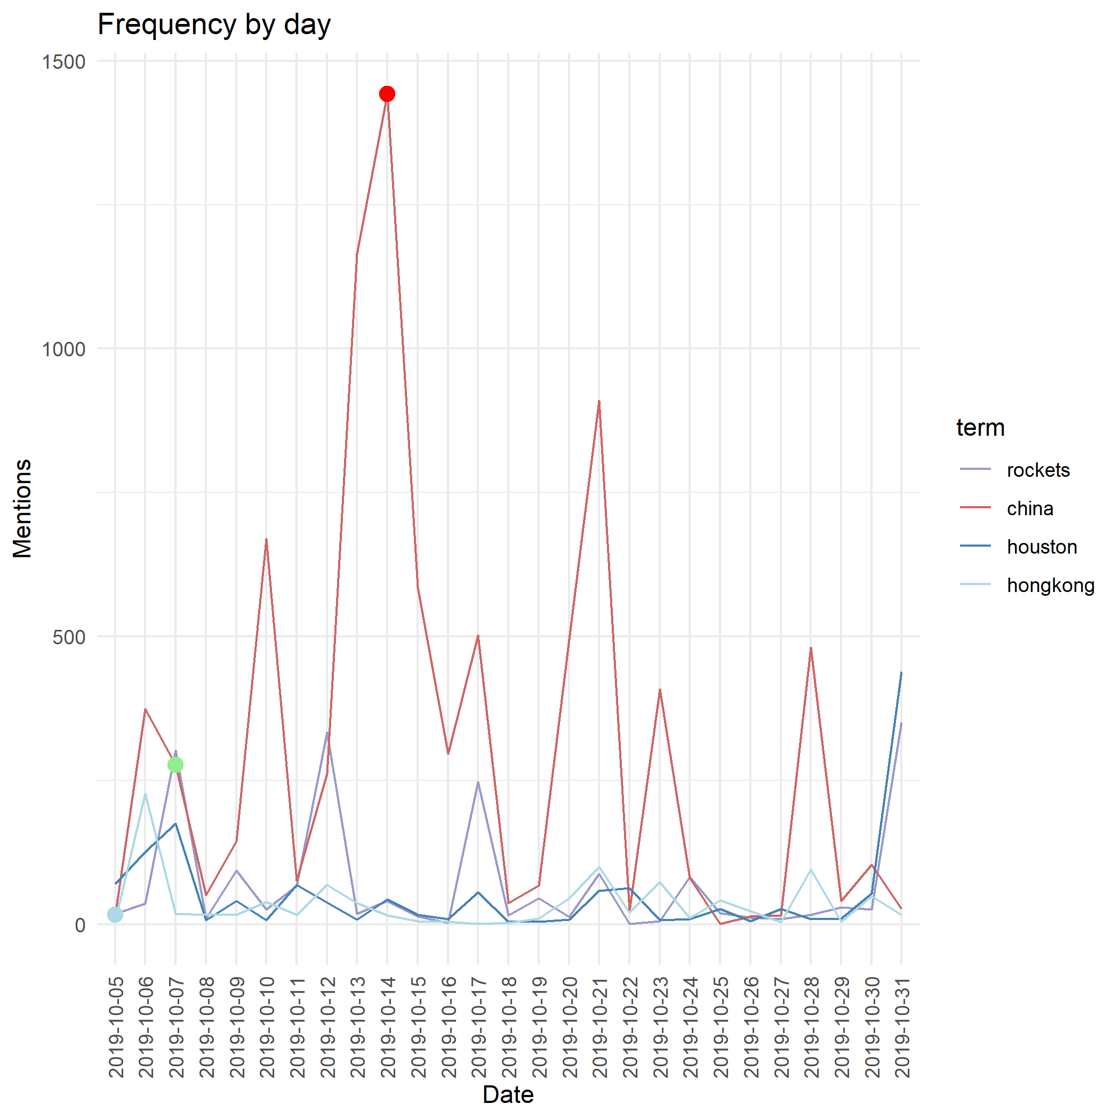

Key Contributors: A timeline
A more granular view
Incident Terms
China, Hong-Kong, Houston & Rockets
Similar observations
Hong-Kong comment extrapolated to China
Team heavily involved

Slide 9
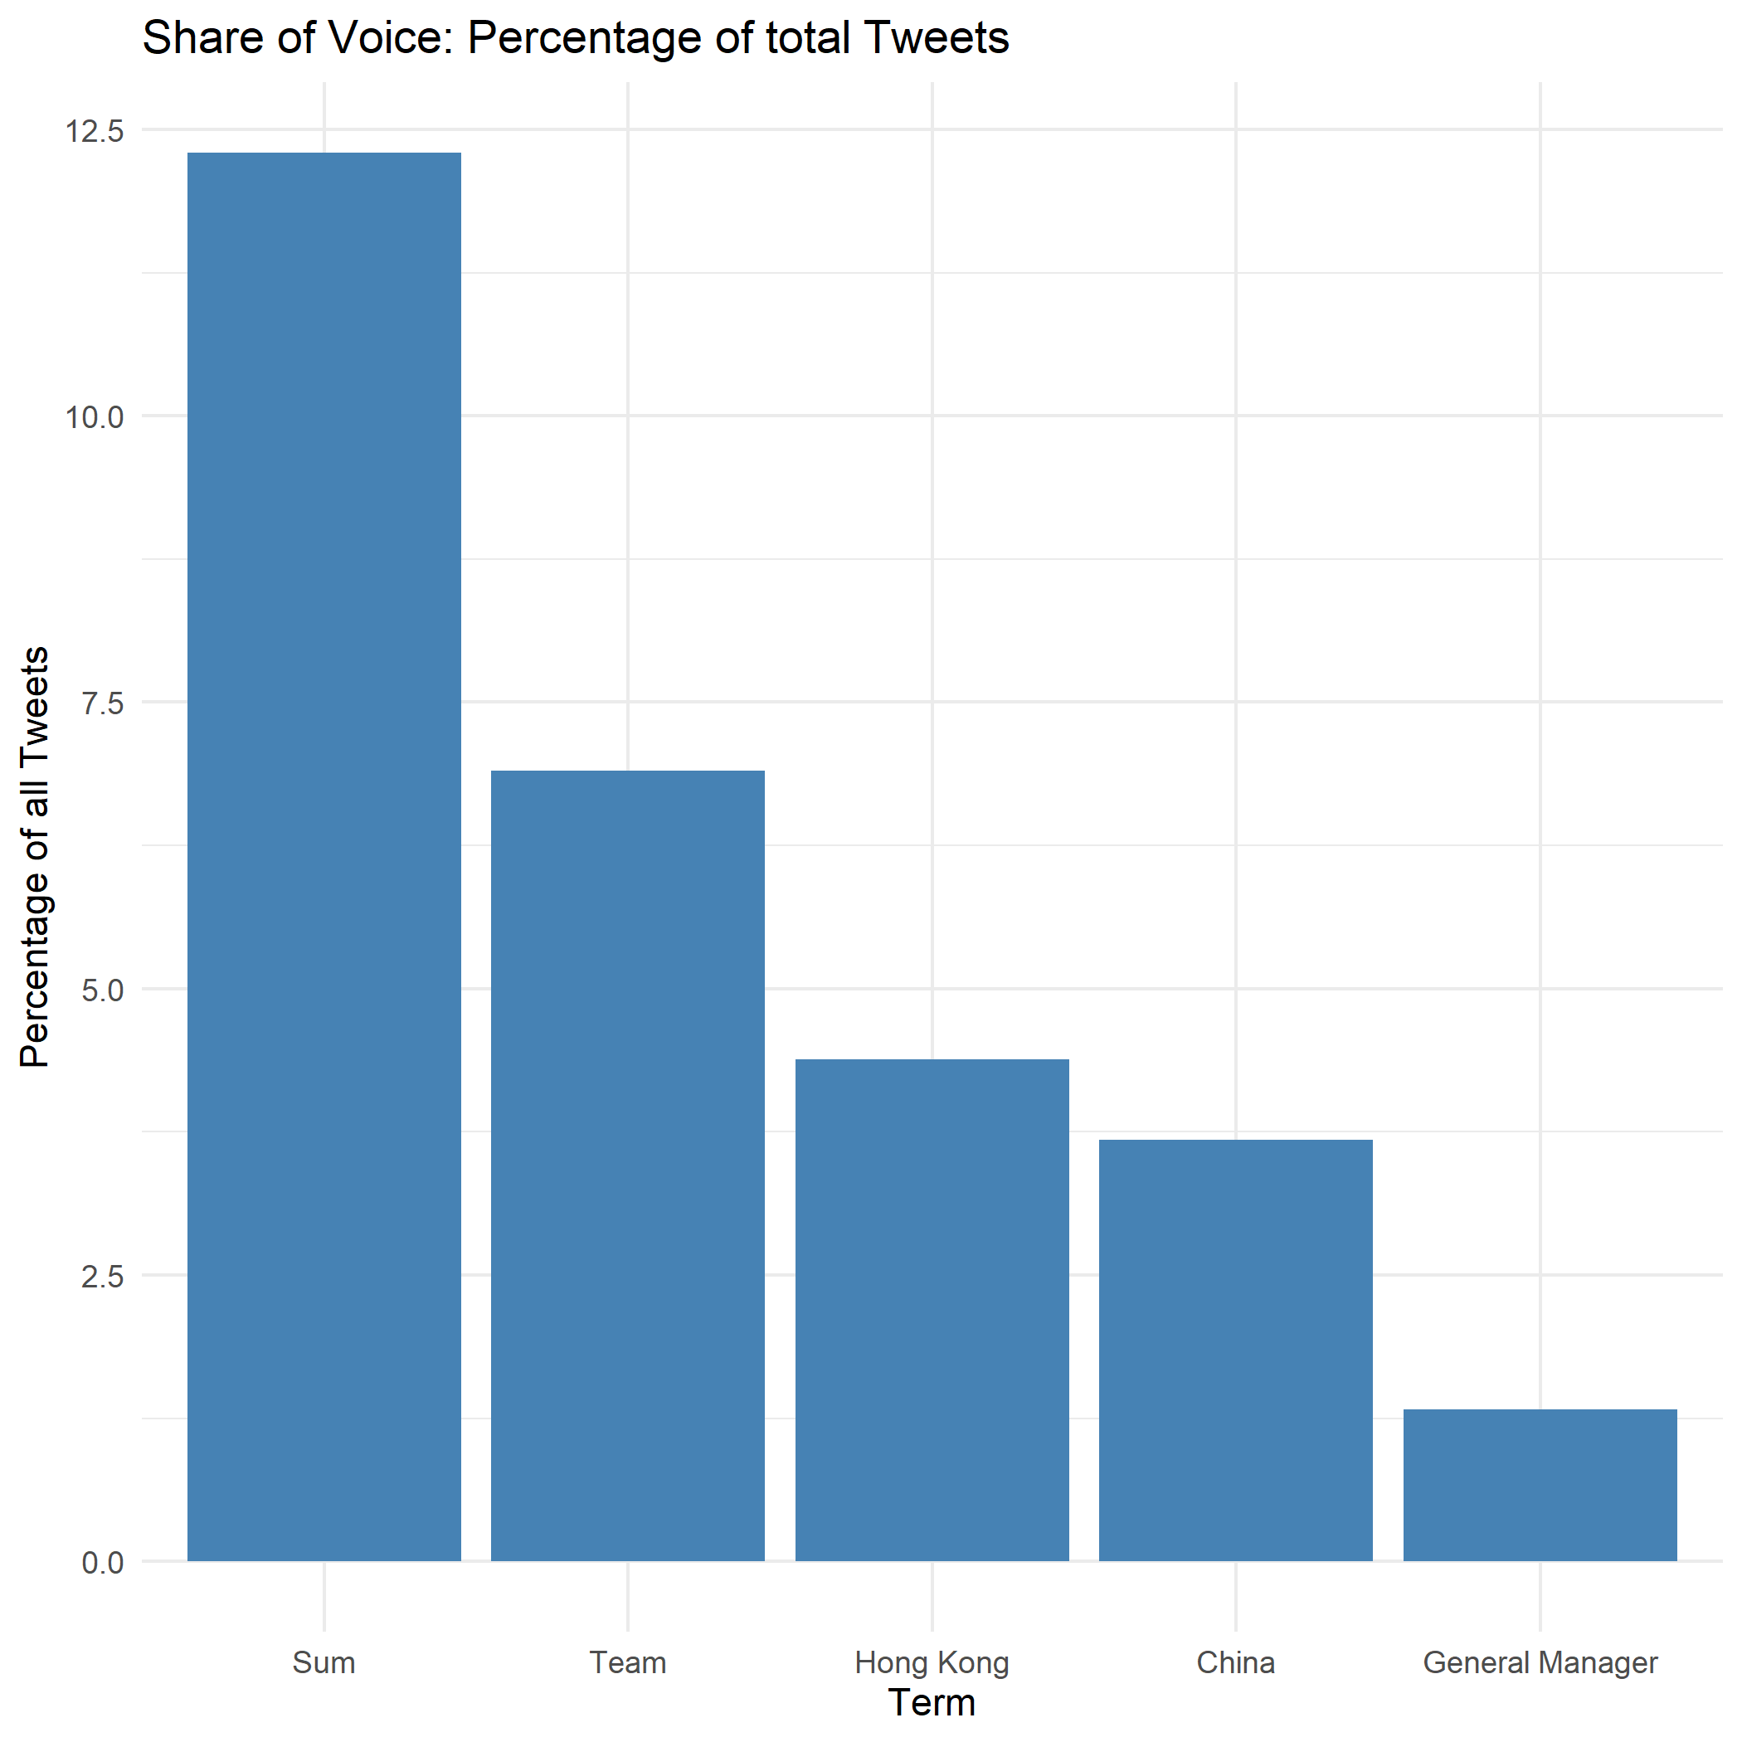
Share of Voice: Does it matter?
The real impact examined
Thus far number of words across all tweets
Need to account for double mentions etc.
Nearly 12.5% of tweets containing a related term
Team (Houston & Rockets)
Hong Kong (All mentions)
China (Only term)
General Manager (Daryl Morey)
Clearly large impact

Slide 10
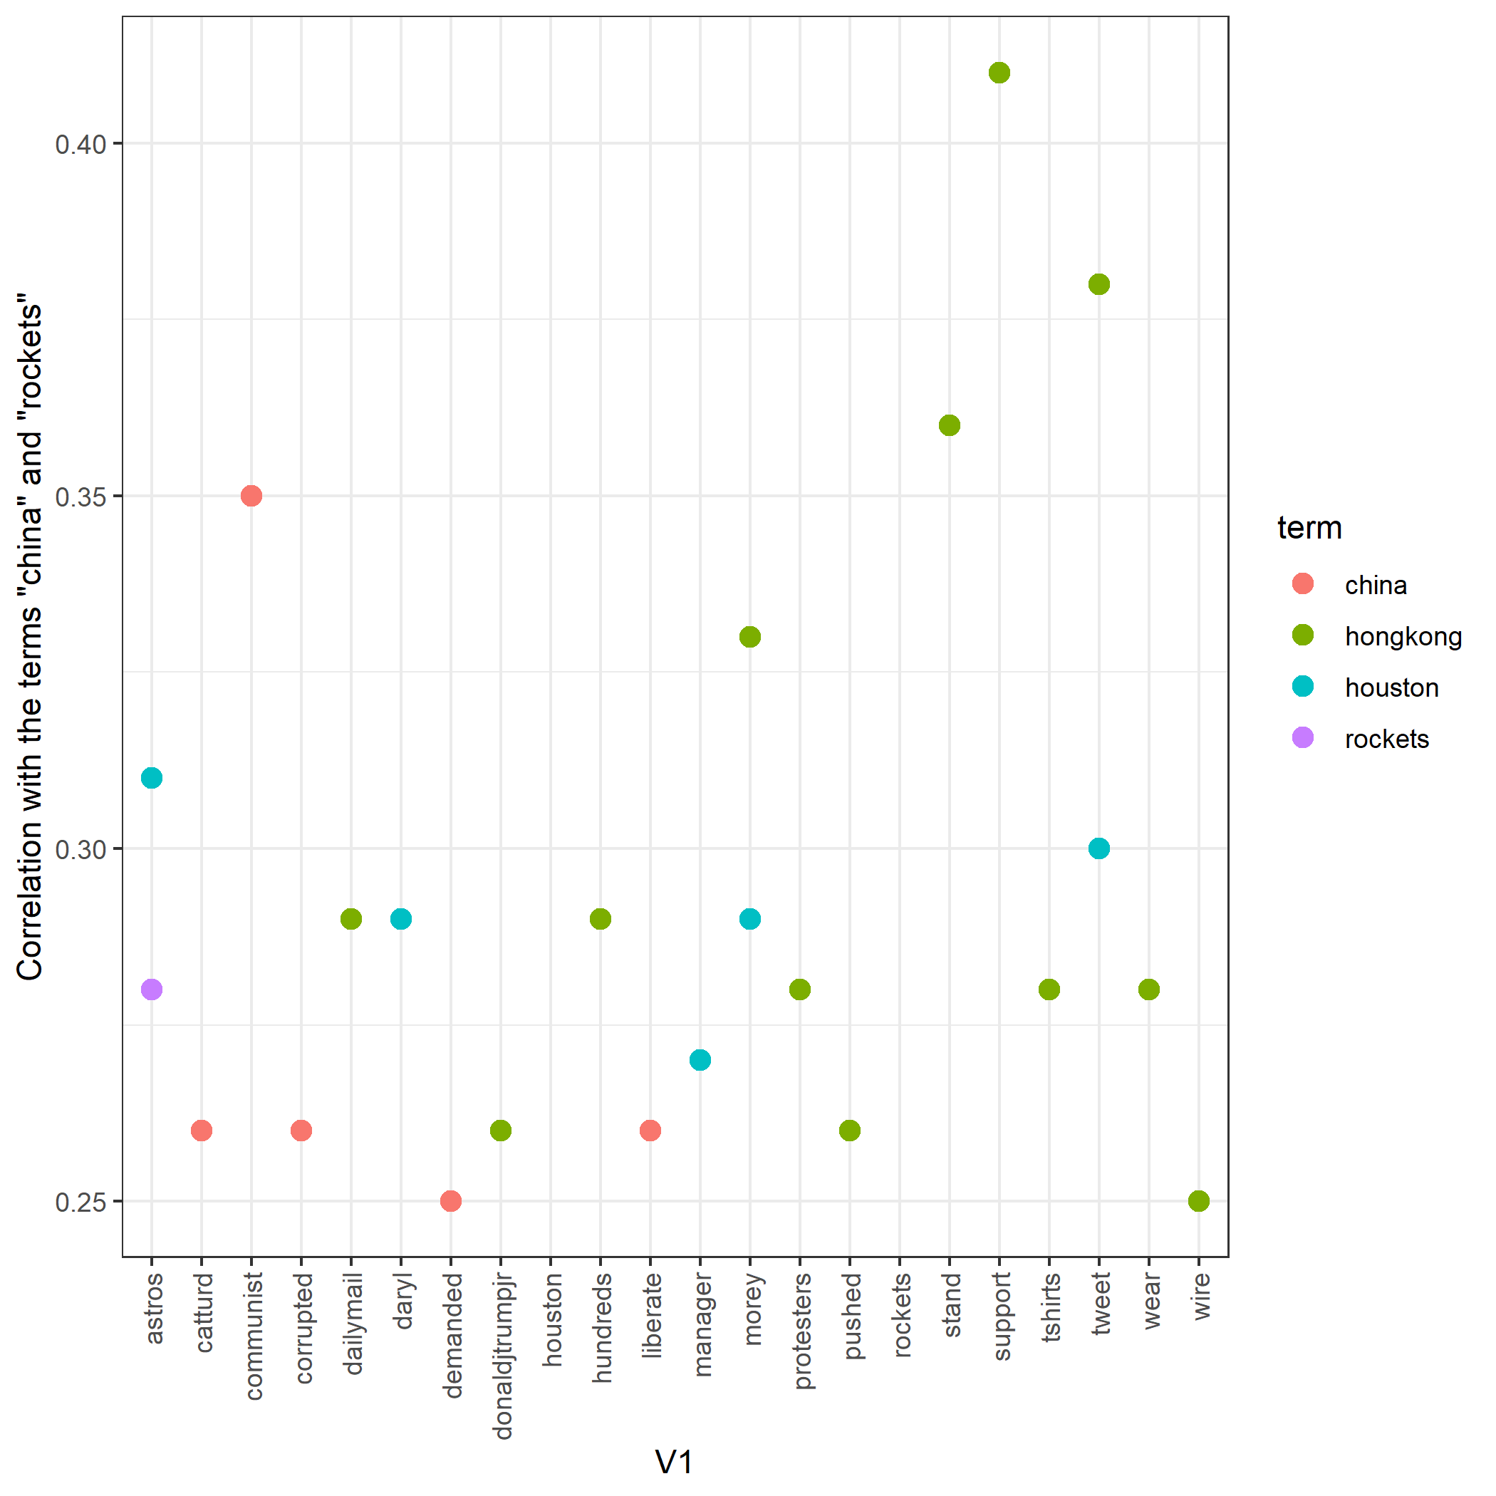
Association Analysis: Who got involved?
The ripple effects
Association analysis confirms previous observations
General manager clearly involved
Rockets/Houston often associated with Hong-Kong and China
Support, tweet, liberate complete picture
Wear association with Hong-Kong alarming

Slide 11
So, why do we care?

Slide 12
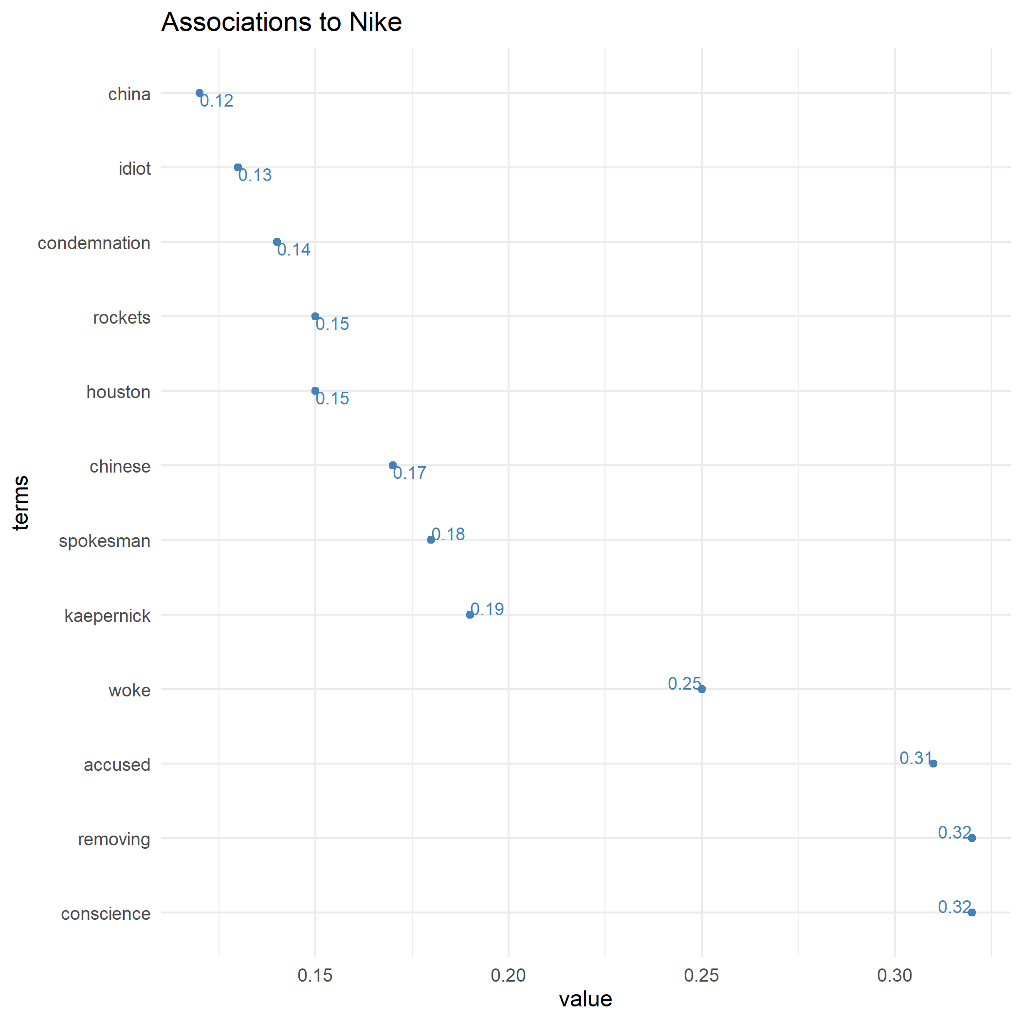
Involvement of Nike
So, why do we care?
Nike Social Responsibility & Market considerations
Nike associated to China, Chines, Houston and Rockets
Other probably related terms such as spokesman, woke, accused etc. also associated
Other crises ongoing: Kaepernick, Ben Shapiro
May influence negative association
(Plot shows selected terms only)

Slide 13
1. You are involved
Don’t underestimate: Nike clearly involved
2. Wait and see
Initial fallout contained
3. Stars matter
Discourse difficult to control – opinions matter
Key
Takeways

Slide 14
Limitations & Further research
What can be improved in the future?
Longer timeframe should be considered
Separating other “crisis” out (Ben Shapiro, Kaepernick etc.)
Sentiment analysis
Other languages

Slide 15
Thank you

